Slide 1
X EDUCATION- LEAD SCORING CASE STUDY (Identification of Hot Leads to focus more on them and thus enhance the conversion ratio for X Education)
GROUP MEMBERS-
Yechuri Mytreya
Vivekanand Mishra
Anju Bani

Slide 2
BACKGROUND X EDUCATION COMPANY
X Education , An education company named sells online courses to industry professionals.
Many interested professionals land on their website.
The company markets its courses on several websites like Google. Once these people land on the website, they might browse the courses or fill up a form for the course or watch some videos.
When these people fill up a form providing their email address or phone number, they are classified to be a lead.
Once these leads are acquired, employees from the sales team start making calls, writing emails, etc. Through this process, some of the leads get converted while most do not.
The typical lead conversion rate at X education is around 30%.

Slide 3
PROBLEM STATEMENT X EDUCATION COMPANY
X Education gets a lot of leads but its lead conversion rate is very poor.
To make this process more efficient, the company wishes to identify the most potential leads, also known as ‘Hot Leads’.
If they successfully identify this set of leads, the lead conversion rate should go up as the sales team will now be focusing more on communicating with the potential leads rather than making calls to everyone
We will help them to select the most promising leads, i.e. the leads that are most likely to convert into paying customers.
We are required to build a model wherein we need to assign a lead score to each of the leads such that the customers with higher lead scores save a higher conversion chance.
The CEO, in particular, has given a ballpark of the target lead conversion rate to be 80%.

Slide 4
LEAD CONVERSION PROCESS
Lead Generation:
1. Ads on websites like Google
2. Referrals
Visit to X Education website by these potential customers (professionals)
Visitors either provide Email id & Contact Details
Or
View videos etc
Tele calling and Emailing activity to all the leads
~30% leads get converted
Lead to the conversion process
Proposed Solution:
A model to filter leads so that leads to conversion ratio is 80%+

Slide 5
PROPOSED SOLUTION
Leads Clustering We cluster the leads into certain categories based on their tendency or probability to convert, thus, getting a smaller section of hot leads to focus more on. | Focus Communication Since we would have a smaller set of leads to communicate with, we m make more impact with effective communication. | Increase conversion Since we focus on hot leads, which were more probable to convert, we would have a better conversion rate, and hence we can achieve the 80% target.
Selection of Hot Leads
Communicating with Hot Leads
Conversion of Hot Leads

Slide 6
SOLUTION SELECTION OF HOT LEADS
For our Problem Solution, the crucial part is to accurately identify hot leads.
The more accurately we obtain the hot lead, the more chance we get of a higher conversion ratio.
Since we have a target of 80% conversion rate, we would want to obtain high accuracy in obtaining hot leads.

Slide 7
IMPLEMENTATION
Loading & Observing the past data provided by the Company
Univariate, Bivariate, and Heatmap for numerical and categorical columns
Performing pre-requisites for RFE and Logistic Regression
DATA GATHERING
DATA CLEANING
PERFORMING EDA
DATA PREPARATION
MODEL BUILDING
Duplicate removal, null value treatment, unnecessary column elimination, etc.
Outlier Treatment, Feature-Standardization

Slide 8
Selection of top 25 features using RFE
Reduction of columns and Model re-building
Verifying our Final Model Accuracy etc. with model built with PCA
Feature Selection
Model Building
Model Improvement
FINAL MODEL
VERIFYING WITH PCA
Model building using RFE for selected columns
Final Model Analysis and performance on Test Data

Slide 9
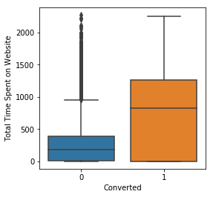
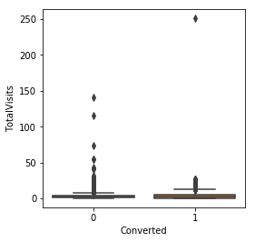
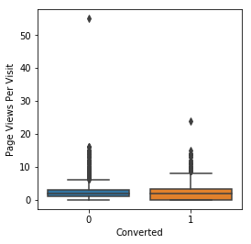
PLOTS VISUALISATION
EDA plots depicting variation in numerical columns for those who Converted and those who didn't.

Slide 10
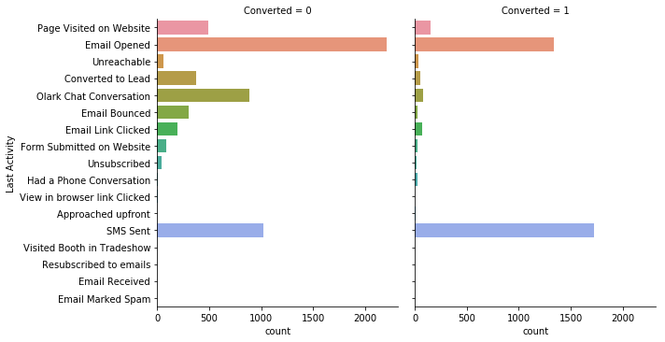
EDA plots depicting variation in categorical column (Last Activity) for those who Converted and those who didn't.

Slide 11
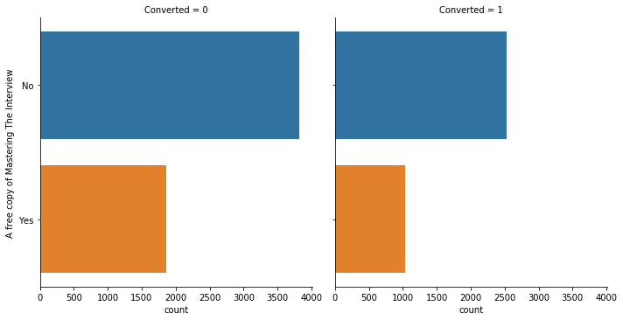
EDA plots depicting variation in categorical column (A free copy of Mastering The Interview) for those who Converted and those who didn't.

Slide 12
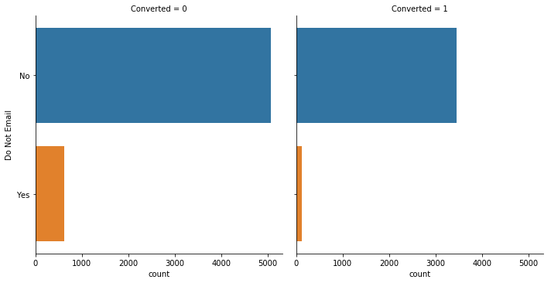
EDA plots depicting variation in categorical column (Do Not Email) for those who Converted and those who didn't

Slide 13
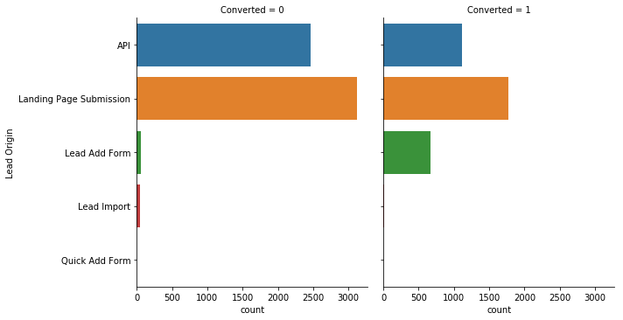
EDA plots depicting variation in categorical column (Lead Origin) for those who Converted and those who didn't.

Slide 14
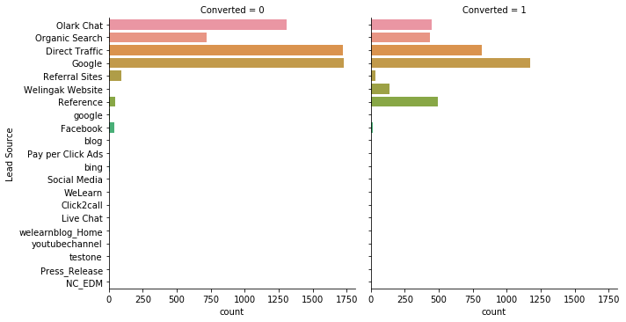
EDA plots depicting variation in categorical column (Lead Source) for those who Converted and those who didn't.

Slide 15
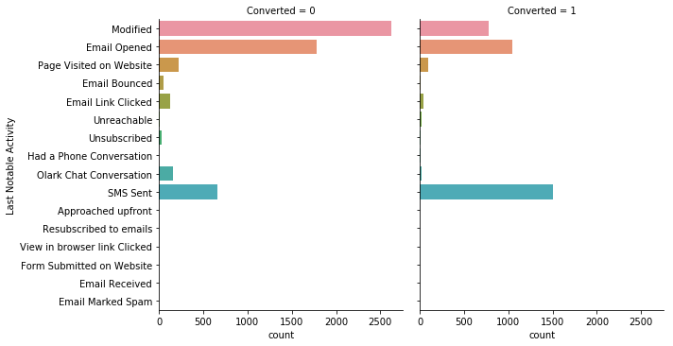
EDA plots depicting variation in categorical column (Last Notable Activity) for those who Converted and those who didn't.

Slide 16
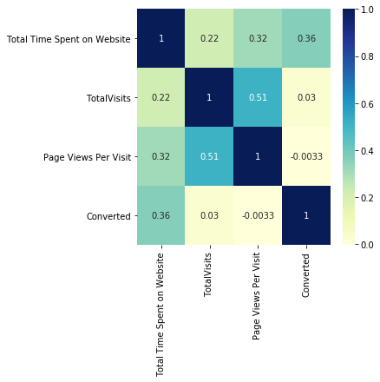
EDA plots depicting correlation (Heat Map) of all selected numerical columns

Slide 17
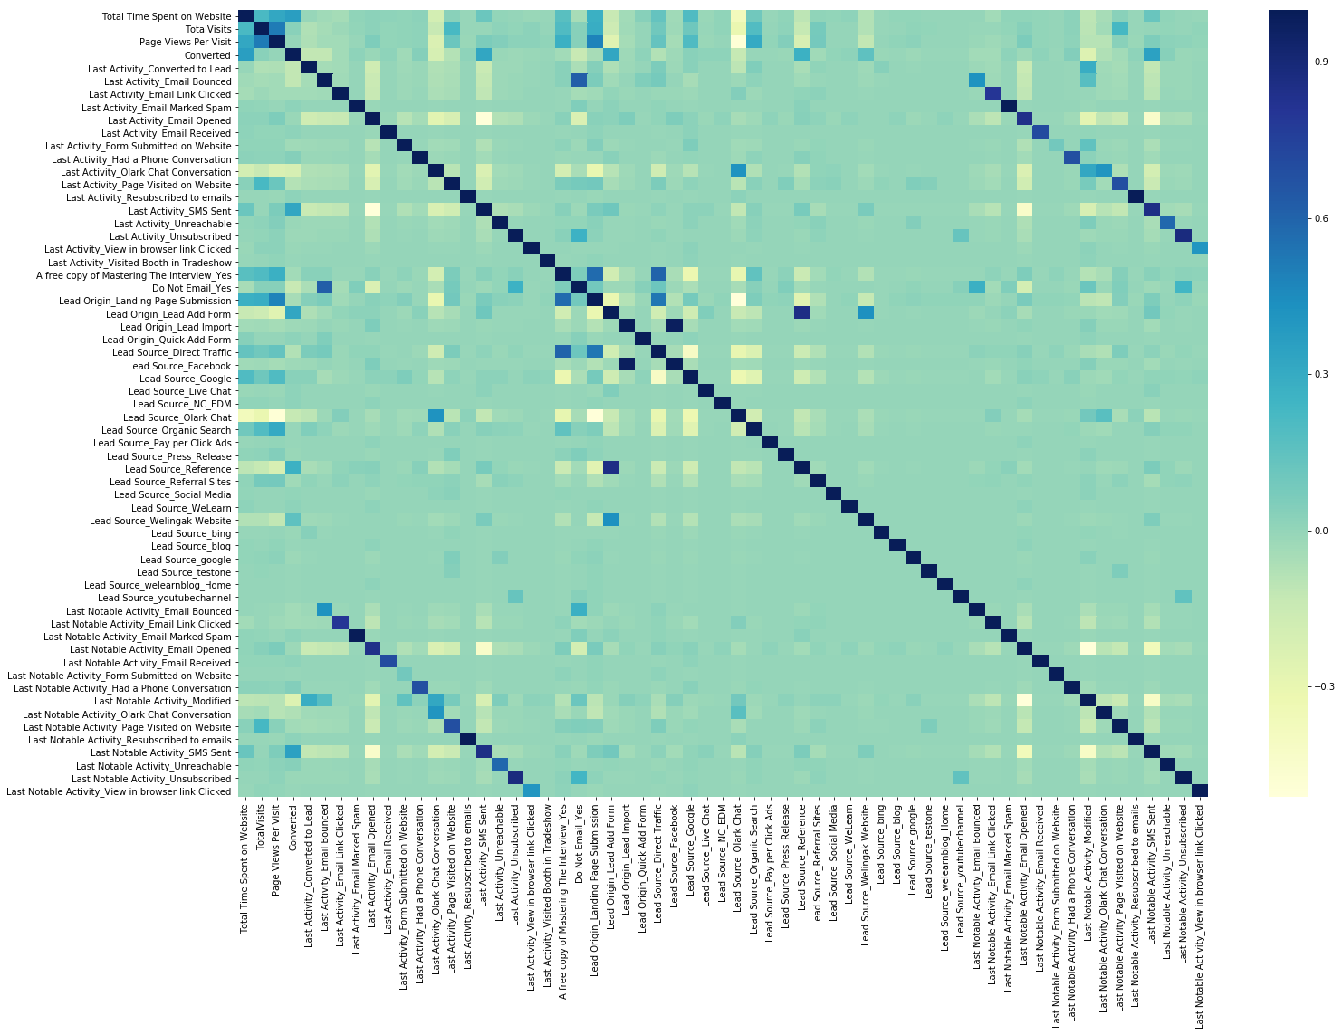
EDA plots depicting correlation (Heat Map) of all selected columns (numerical columns and dummy columns).

Slide 18
MODEL ANALYSIS
Performance of our Final Model
Overall accuracy on Test set: 0.786
Sensitivity of our logistic regression model: 0.733
Specificity of our logistic regression model: 0.823

Slide 19
Inferences from Model
Business Insights Derived from our Model
The top 3 variables in the model, that contribute towards lead conversion are:
Total Time Spent on the Website
Last Notable Activity_SMS Sent
TotalVisits
The top 3 variables in my model, that should be focused on are:
Last Activity_SMS Sent (positively impacting)
Last Activity_Olark Chat Conversation (negatively impacting)
Lead Source_Olark Chat (negatively impacting)

Slide 20
Conclusion 1 (LR Model)
Our Logistic Regression Model is decent and accurate enough when compared to the model derived using PCA, with 78.6 % Accuracy on Test Set, 73.3 % Sensitivity, and 82.3 % Specificity.
We can vary these parameters by varying the cut-off value and thus predict Hot leads based on scenarios like the availability of extra resources and vice-versa.

Slide 21
Conclusion 2
X Education Company needs to focus on the following key aspects to improve the overall conversion rate:
Increase user engagement on their website since this helps in higher conversion
Increase sending SMS notifications since this helps in higher conversion
Get Total visits increased by advertising etc. since this helps in higher conversion
Improve the Olark Chat service since this is affecting the conversion negatively.

Slide 22


THANK YOU!!

